Slide 1
834 Observations in the SPINR Data
Ryan Maguire

Slide 2
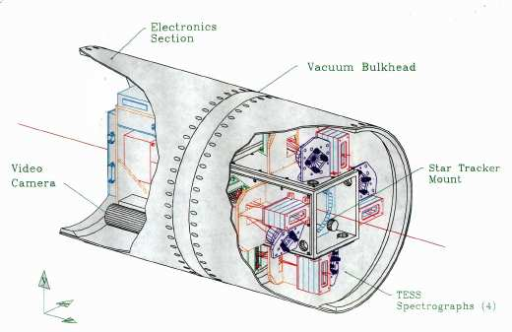
The Experiment
SPINR was a rocket the flew in the late 1990’s to gather data on the emission spectrum of the dust in young nebulae
The mission used spectrographs developed by the TERRIERS Satellite mission to image ultraviolet emissions from both the Scorpius and Orion constellations.
All missions flew from White Sands Missile Range well into the night.

Slide 3
The Problem
The data produced by the SPINR mission had an unexplained observation, that of 83.4 nm emission lines.
This wavelength should not be observed in the spectrum of far away objects as these photons are capable of ionizing hydrogen atoms.
The purpose of this capstone is to explore some possibilities as to what might have occurred, particularly in the Orion data.

Slide 4
Some Physics
We know the 834 lines are not from the Orion as Hydrogen can be ionized by 911 photons.
Assuming a uniform density of 1 atom per cc, and from the Beer-Lambert law, this yields a mean free path of roughly 1 AU.
The probability of traversing some distance without collision decays exponentially.
As Orion is over a million AU away, the probability that 834 photons reached the Earth from Orion is 0 to hundreds of decimal places.

Slide 5
Possible Resolutions
834 is produced in the emission spectrum of both O⁺ and O⁺⁺, both of which are found in the upper atmosphere.
If sunlight is capable of interacting with these atoms, then an 834 line would be expected in the data.
The problem is then to find out if it is feasible the O⁺ or O⁺⁺ interacted with sunlight at the time of the experiment.

Slide 6
These interactions could have came about in several different ways.
It is possible that there was O⁺ very high in the atmosphere, and thus out of the umbra/penumbra of the Earth.
Another possibility is that the line of sight of the Rocket reaches the cone of the umbra at a relatively low altitude, where there is an abundance of these atoms.
The conjugate point of White Sands could possibly have been in the sun while this experiment took place, meaning conjugate electrons could have excited the atoms enough to produce 834 emissions.
Reflected UV light off of the moon from the sun could also cause the interactions needed to produce this spectrum.

Slide 7
The Geometry
The overwhelming majority of this project was focused on the geometry of the experiment. A brief derivation will be given to show how the results were obtained.
Two of the explanation are completely dependent on the point in space where the line of sight of the Rocket meets the cone of the umbra (And to lesser extent, the penumbra).
If this point is low enough that O⁺ was being hit by sunlight, then the problem is solved.

Slide 8
Equatorial Coordinates
This problem needs 4 different coordinate systems to effectively determine the line of sight of the rocket, the cone of the umbra, and the cone of the penumbra.
The Orion constellation is easily found with equatorial coordinates, which uses right ascension and declination to determine points on the celestial sphere.
The coordinates of Orion are easy enough to remember, they are RA = 5, Dec = 5.

Slide 9
Horizontal Coordinates
The horizontal coordinate system is based on the position of the observer.
As such it is dynamical, unlike the equatorial system, and as such two observers will have two different coordinate systems.
The coordinates involve the tangent plane to the Earth at the point of the observer, and the set of concentric cones centered at the observer.
The first coordinate is the azimuthal angle, which is the angle made on the tangent plane from the direction north to the direction the observer is facing.
The second coordinate is the altitude which is the angle above the tangent plane that the observer is facing.
Thus, a point in space is uniquely determined by a half-plane perpendicular to the tangent plane, and a cone centered at the observer.

Slide 10
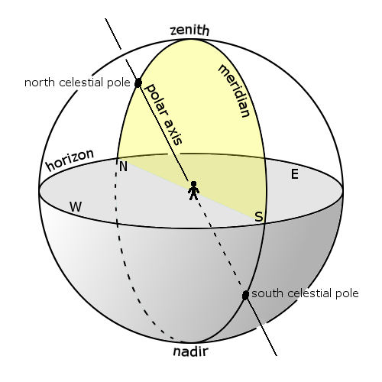
In terms of astronomy, the altitude is the angle complimentary to the angle between the line of sight and the zenith.
We can convert between equatorial and horizontal coordinates if we know the latitude of the observer and the local sidereal time.

Slide 11


Converting Between Systems
The above equations can be used to quickly convert between horizontal and equatorial coordinates.
Here a is the azimuthal angle, A is the altitude, delta is the latitude of the observer, phi is the declination of the object, and H is the hour angle. The hour angle is defined below, LST is the local sidereal time and alpha is the right ascension (LHA is local hour angle).

Slide 12
Cartesian Coordinates
The final two systems are both Cartesian, and have the same angle.
Lines and cones in three dimensions are very easily described with analytical geometry when Cartesian coordinates are used.
The need for two Cartesian coordinates arises when one tries to write the parametric equations for circles that are not concentric with the origin, nor perpendicular or parallel to one of the axis.
The first system takes the south-to-north pole as the positive z-axis, core to prime meridian as the x-axis, and the core to 90th east as the y axis.
The second Cartesian system takes the Earth’s core to the sun’s core as the positive z axis. The x-axis and y-axis of the system do not matter.

Slide 13
The Apology of A Mathematician
Geometric problems like this are the main focus of algebraic geometry.
Algebraic geometry takes smooth (Infintely differentiable surfaces) objects in n-dimensional topological spaces and determines their intersections.
The topological structures considered here are Euclidean (Real), and thus very nice to work with.
The methods of algebraic geometry involve Abelian groups, commutative algebras, and some exterior calculus.
To avoid confusing people, the use of Euclidean, analytic, vector geometries were used instead.
This creates quite the mess, however.

Slide 14
From the results obtained we come across two problems:
How is the O⁺ is that high when hydrogen dominates the exosphere?
Can O⁺ be excited via some other mechanism in the dark?

Slide 15
Conjugate Points
A conjugate point is the point of intersection with the Earth one would come across if they were to follow the magnetic field lines from some fixed point on the Earth’s surface.
Conjugate electrons are electrons that are excited at the conjugate point and then travel down the field lines to the original point.
A solution proposed to a similar problem in the 1970’s was the conjugate electrons were exciting the oxygen in the atmosphere, and thus causing the 834 emissions.
It is possible that the conjugate point of White Sands was exposed to the sun at the time of the experiment, therefore allowing electrons to interact with the O⁺ and produce 834

Slide 16
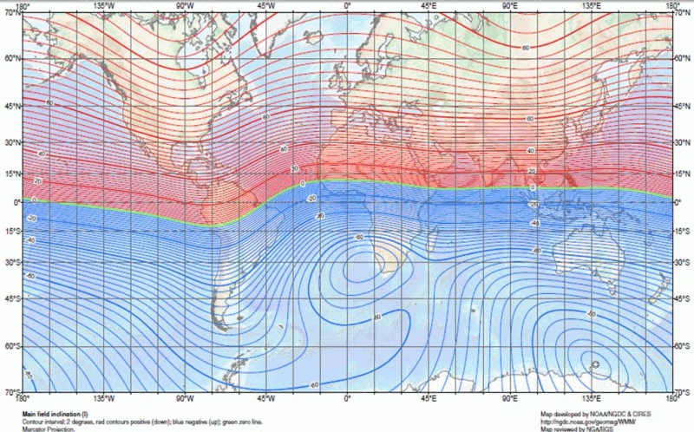
Feasibility

Slide 17
The conjugate point of White Sands is slight above Antarctica, and on the same face of the Earth.
This means that it was also dark during the time of the experiment.
It becomes harder to accept that conjugate electrons are the main source, as if atoms can be excited in the dark over Antarctica, why not over New Mexico as well?

Slide 18
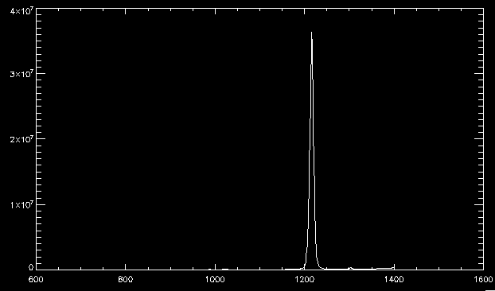
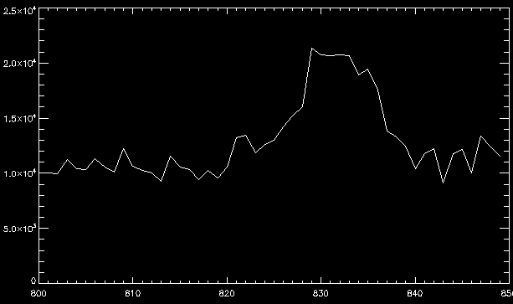
Data

Slide 19
Comparison
The paper from the 1970’s had a figure of 15 R ± 5 R.
The data gather has a value of 8 R, with about a 15% uncertainty.
This seems very compelling to further investigate the data, as all 3 flights had similar observations.

Slide 20
Conclusion
It is possible that there is O⁺ very high up in the atmosphere that is causing the 834 lines, or that there is some mechanism that creates a spectrum even at night.
The conjugate electron hypothesis has results that are very close to other reports, but this seems unfeasible as the conjugate point was also in the dark.
Further analysis of the data is needed to make a better conclusion, but from this we can start to exclude several possibilities.

